Slide 1







Hydrology ETL Pipeline – Architecture & Processing
PROJECT PURPOSE
ENVIRONMENT & CONFIG
EXTRACT PHASE
→
Automated extraction of hydrology station HIPPER_PARK ROAD BRIDGE_E_202312
→
Dynamic loading via dotenv variables
→
check_api_reachable(): Connectivity check
→
Keys: BASE_URL, TARGET_PARAMETERS
→
Transform raw API JSON into Star Schema
→
Centralized DB_PATH for storage
→
extract_measures(): Discovers station metadata
→
Custom logging for end-to-end traceability and monitoring.
Filters measures by TARGET_PARAMETERS
→
Target: Analytical storage in SQLite database
→
→
extract_readings(): Latest 10 records per item
→
TARGET_PARAMETERS = ["DISSOLVED OXYGEN", "CONDUCTIVITY"]
TRANSFORM PHASE: TRANSFORM()
STAR SCHEMA DESIGN
→
Aggregates findings from extraction modules
→
Converts raw strings to datetime objects
dim_station - station_id (PK) - station metadata
dim_measure - parameter_id (PK) - measure metadata
fact_readings - fact_id (PK) - FK: station, measure - values, quality mapping
→
Handles missing/malformed timestamps gracefully
→
Normalizes text: strip() and lower()
→
Enriches data with station-measure relationship IDs
Author: Adewale Ilesanmi

Slide 2
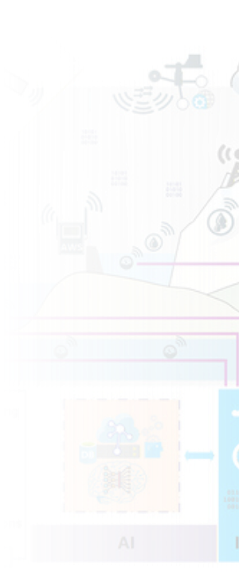






Database Load & Full Pipeline Execution
LOAD PHASE
LOADING DATA
PIPELINE ORCHESTRATION
→
create_tables(): Resets schema state
→
load_to_sqlite(): SQLite session handler
→
run_pipeline(): Main sequence controller
→
Strict Schema: TIMESTAMP, NUMERIC
→
Enforces Primary & Foreign Key integrity
→
Uses pandas .to_sql() for high-performance loading
→
Synchronizes Transform → Load sequence
TABLES & VALUE INSERTED
→
Protected by __name__ == "__main__"
→
dim_stations : Value {1}
dim_measures : Value {3}
fact_readings : Value {30}
→
Appends: dim_station, dim_measure, fact_df
→
→
KEY DESIGN DECISIONS
→
Modular Separation: E/T/L decoupling
→
Warehouse Ready: Surrogate Keys
Star Schema Model
→
Error Handling: API & Format resilience
→
Traceability: Full logging coverage
Ensures Data Normalization, Referential Integrity, and Analytics Scalability
END-TO-END EXECUTION FLOW SUMMARY
Hydrology API
Extract Measures
Transform Logic
Star Schema Builder
SQLite Loader
Analytics Ready
Author: Adewale Ilesanmi

